Slide 1
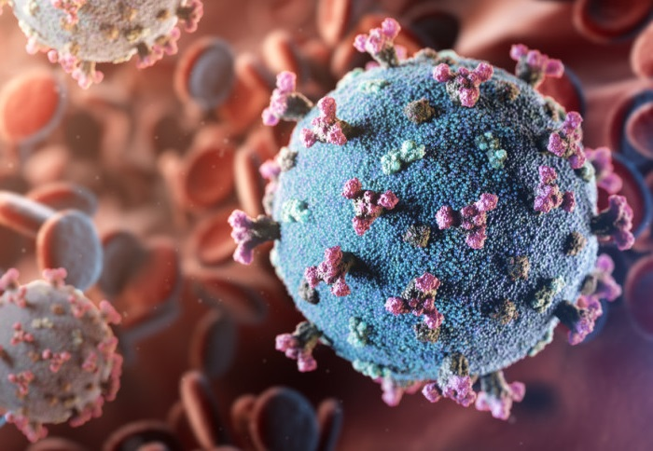

IT2022E
Applied Statistics &
Experimental Design
GROUP 10
COVID-19 INFECTION PREDICTION METHODS:
A COMPREHENSIVE ANALYSIS

Slide 2



Introduction
Description, Background and Overview

Slide 3
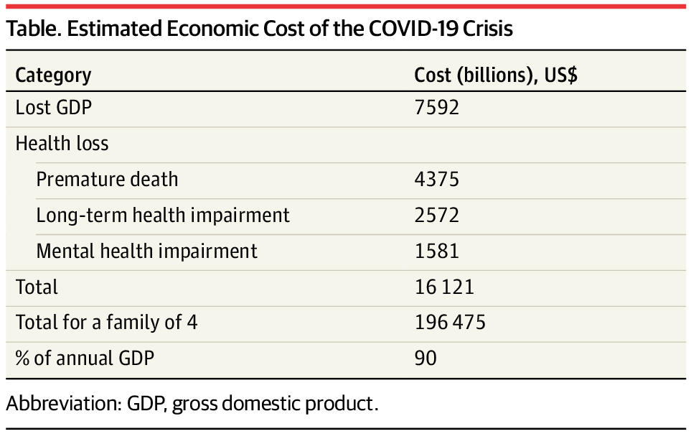

Problem Overview
The need for correct predictions
The total of economic losses in the USA, JAMA (2020)
Overview | Data Collection | Data Processing | Models | Results | Conclusion
3

Slide 4
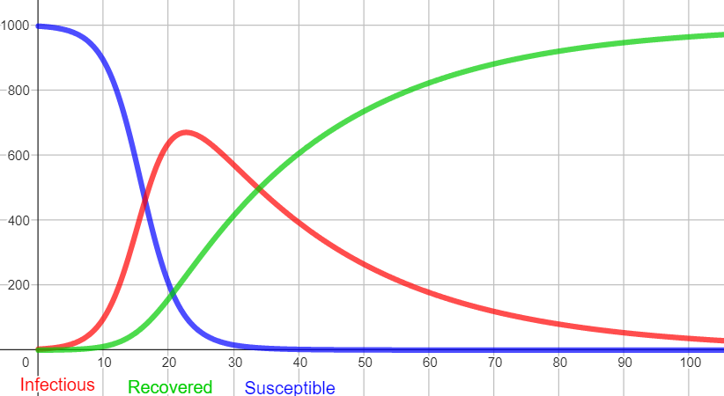
Problem Overview
The need for correct predictions
Overloading of the healthcare system
Overview | Data Collection | Data Processing | Models | Results | Conclusion
4

Slide 5
Problem Overview
Overview of models in use
Models
Compartmental Models
Includes SIR (Susceptible – Infectious – Recovered) model and other derivatives.
Deep Learning Models
Recurrent Neural Networks, Long-Short Term Memory, Gated Recurrent Unit, Stacked LSTM and Convolutional LSTM.
ARIMA Model
a.k.a AutoRegressive Integrated Moving Average
Overview | Data Collection | Data Processing | Models | Results | Conclusion
5

Slide 6
Problem Overview
Overview of models in use
Traditional compartmental models:
Population
Susceptible
Infected
Recovered
The SIR model: Partitioning the population into “compartments”
Overview | Data Collection | Data Processing | Models | Results | Conclusion
6

Slide 7
Problem Overview
Problem Statement
Input
Daily reported COVID-19 cases in a region.
Additional features: death counts, vaccination details, etc.
Output
Predict the number of COVID-19 cases over the next seven days.
Goals
Evaluate model performance in predicting infection cases.
Explain how government policies and real-life events influence the pandemic's spread and prediction outcomes.
Overview | Data Collection | Data Processing | Models | Results | Conclusion
7

Slide 8
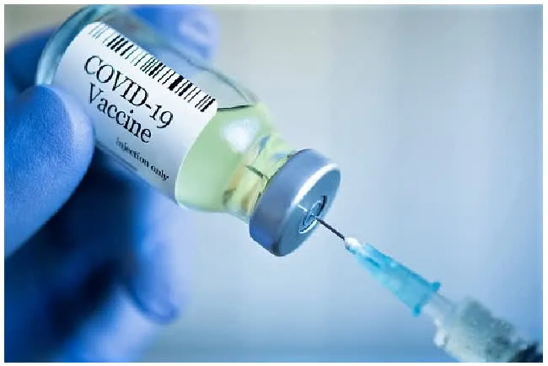
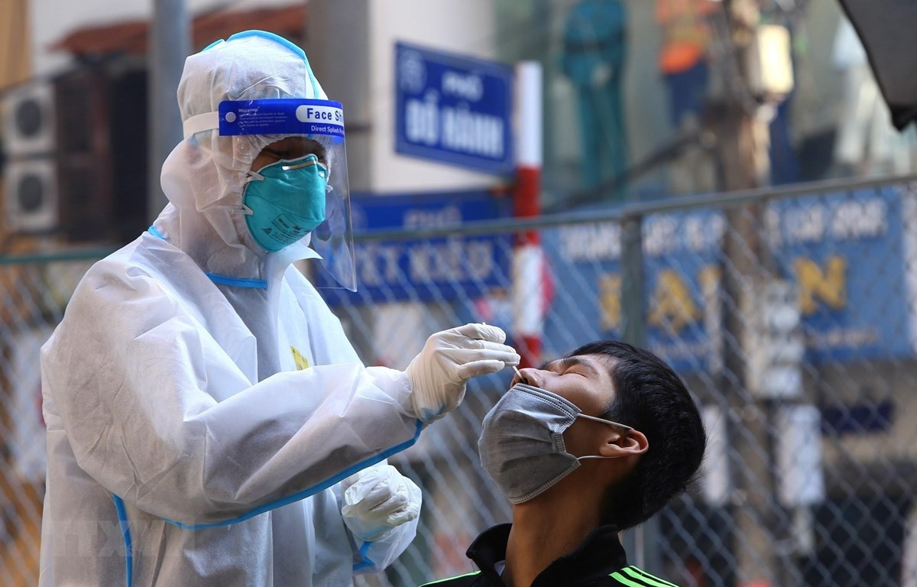

Data Collection
With Exploration and Visualisation

Slide 9
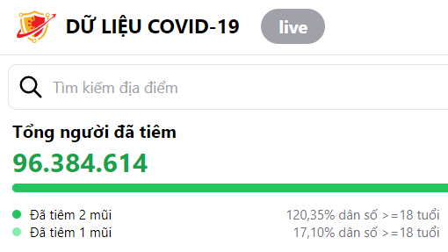

Data Collection and Exploration
Scraping Data from Official Sites
Data sources:
Vietnamese Ministry of Health COVID-19 data portal - Hanoi case data
Google COVID-19 Mobility Reports - Movement trends by location type
Time period: 2020-2022 (3 years)
Rationale:
Analyze policy impact on Hanoi case data.
Understand policy evolution in response to the pandemic (using mobility trends).
Overview | Data Collection | Data Processing | Models | Results | Conclusion
9

Slide 10
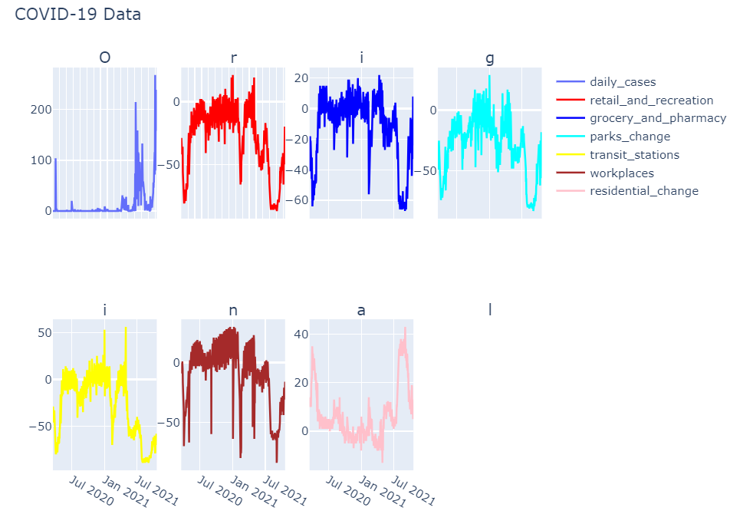
Data Collection and Exploration
Scraping Data from Official Sites
Overview | Data Collection | Data Processing | Models | Results | Conclusion
10

Slide 11
Data Collection and Exploration
Unveiling our Dataset: Exploratory Data Analysis (EDA)
Dataset Overview
Dates
1009 days: February 2, 2020 – November 19, 2022
Features
Numerical, except 'Date'
Cleaning Records
Remove NaNs
Remaining Dates
581 days: March 18, 2020 – October 19, 2021
Overview | Data Collection | Data Processing | Models | Results | Conclusion
11

Slide 12
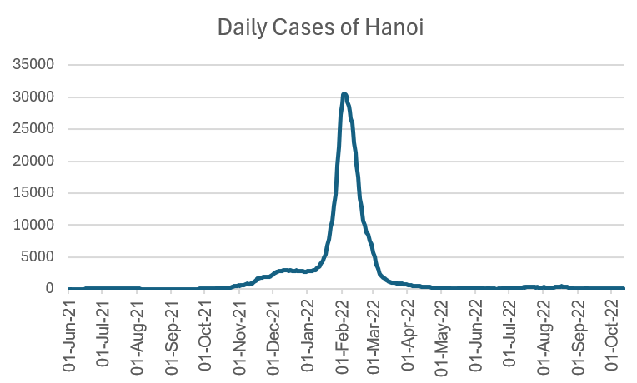
Data Collection and Exploration
Unveiling our Dataset: Exploratory Data Analysis (EDA)
Overview | Data Collection | Data Processing | Models | Results | Conclusion
12

Slide 13
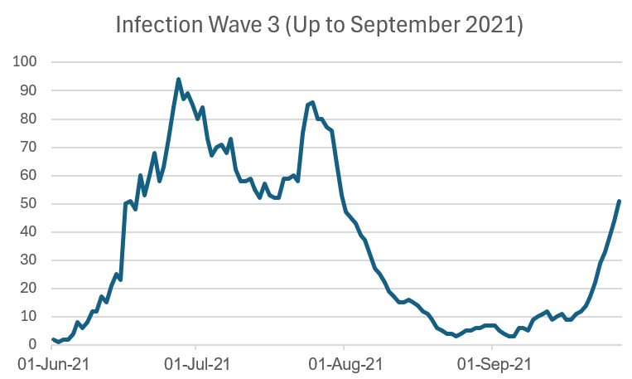
Data Collection and Exploration
Unveiling our Dataset: Exploratory Data Analysis (EDA)
Overview | Data Collection | Data Processing | Models | Results | Conclusion
13

Slide 14
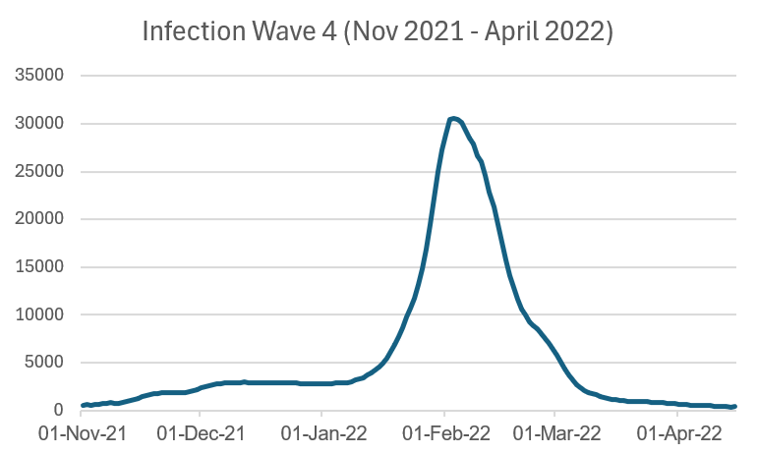
Data Collection and Exploration
Unveiling our Dataset: Exploratory Data Analysis (EDA)
Overview | Data Collection | Data Processing | Models | Results | Conclusion
14

Slide 15
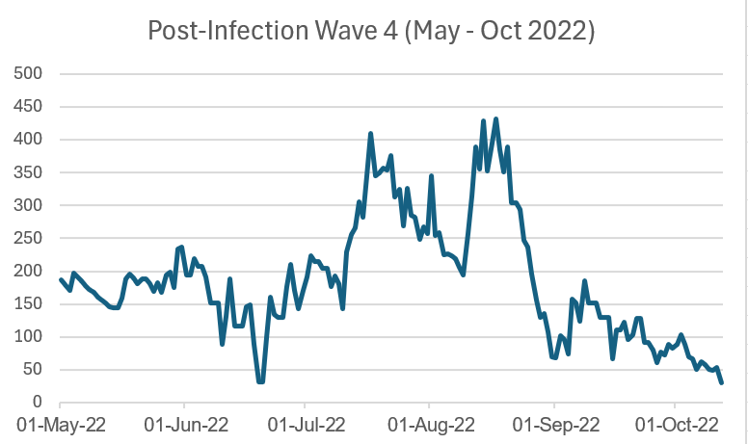
Data Collection and Exploration
Unveiling our Dataset: Exploratory Data Analysis (EDA)
Overview | Data Collection | Data Processing | Models | Results | Conclusion
15

Slide 16
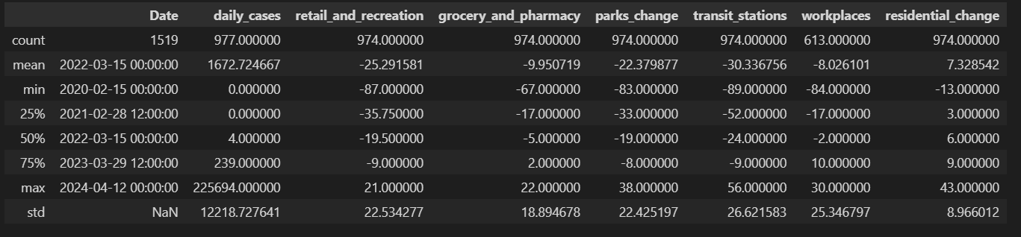
Data Collection and Exploration
Unveiling our Dataset: Exploratory Data Analysis (EDA)
Overview of daily COVID-19 cases and changes in mobility across various sectors
Overview | Data Collection | Data Processing | Models | Results | Conclusion
16

Slide 17
Data Collection and Exploration
Unveiling our Dataset: Statistical Summary and Visualization
df.describe()
Similar range and distribution across policies
Policy stringency decreases with the rise in daily cases
Lag observed between policy peak and disease peak
Overview | Data Collection | Data Processing | Models | Results | Conclusion
17

Slide 18

Data Processing
For Improved Understanding

Slide 19
Data Collection and Exploration
Data Processing Overview
Data Partitioning:
80% training, 20% testing; predict disease spread for the next 14 days
Feature Normalization:
Normalize to mean of 0 and standard deviation of 1
Lag Features:
Create lagged versions of target column (lags of 1, 2, 3 days)
Remove resulting NaN values
Expanding Rolling Window:
New column with average of previous N-1 rows in target column
Overview | Data Collection | Data Processing | Models | Results | Conclusion
19

Slide 20

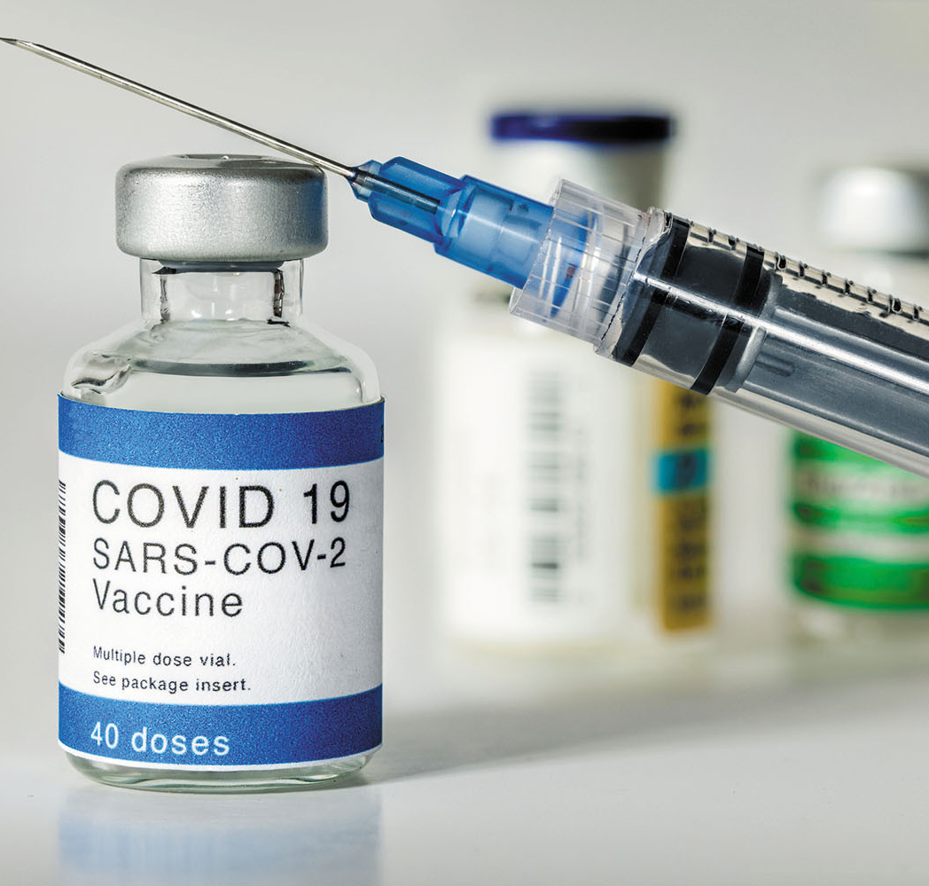
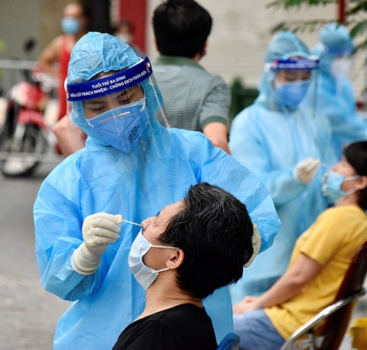
Models
Different Approaches to Solving the Problem

Slide 21
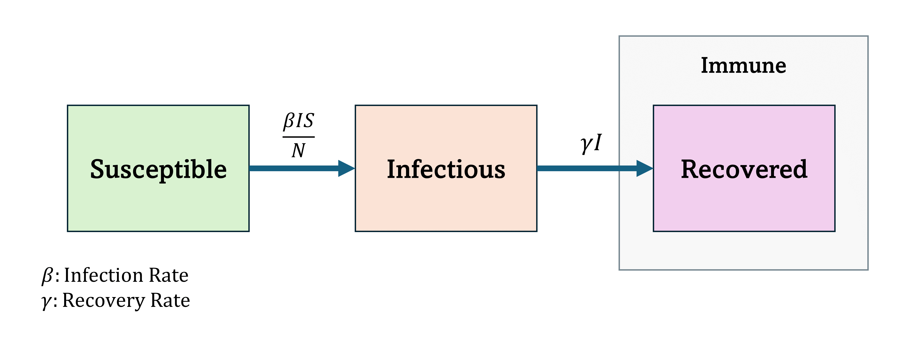
Traditional Models: SIR
Susceptible – Infectious – Recovered
(*) Lower $β$ signify stricter preventive methods and social distancing.
Higher $γ$ signify better healthcare and faster recovery.
Overview | Data Collection | Data Processing | Models | Results | Conclusion
21

Slide 22
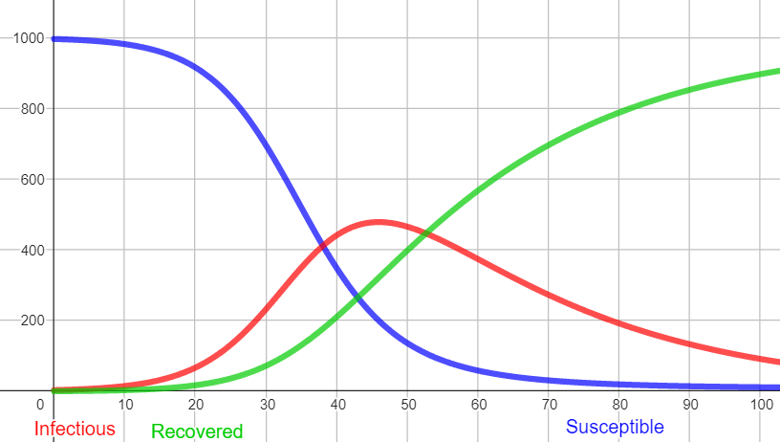


Traditional Models: SIR
Susceptible – Infectious – Recovered
“Flattening the curve” - SIR Model Diagrams with $S=997, I=3, R=0$
a) $β=0.0005, γ=0.04$
b) $β=0.0002, γ=0.04$
(*) Lower $β$ signify stricter preventive methods and social distancing.
Higher $γ$ signify better healthcare and faster recovery.
Overview | Data Collection | Data Processing | Models | Results | Conclusion
22

Slide 23
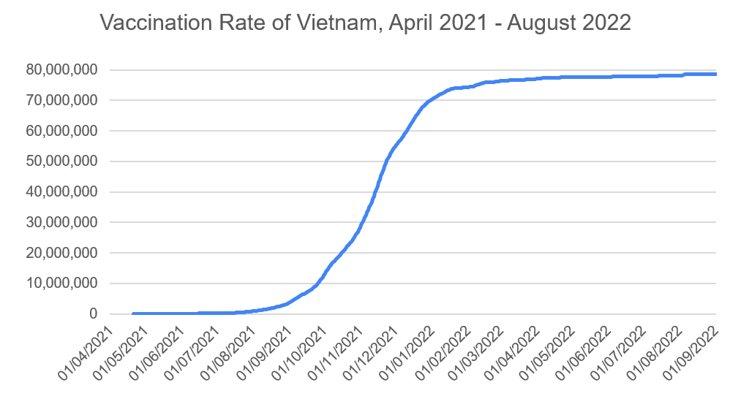
Traditional Models: SIRV
Susceptible – Infectious – Recovered – Vaccinated
Overview | Data Collection | Data Processing | Models | Results | Conclusion
23

Slide 24
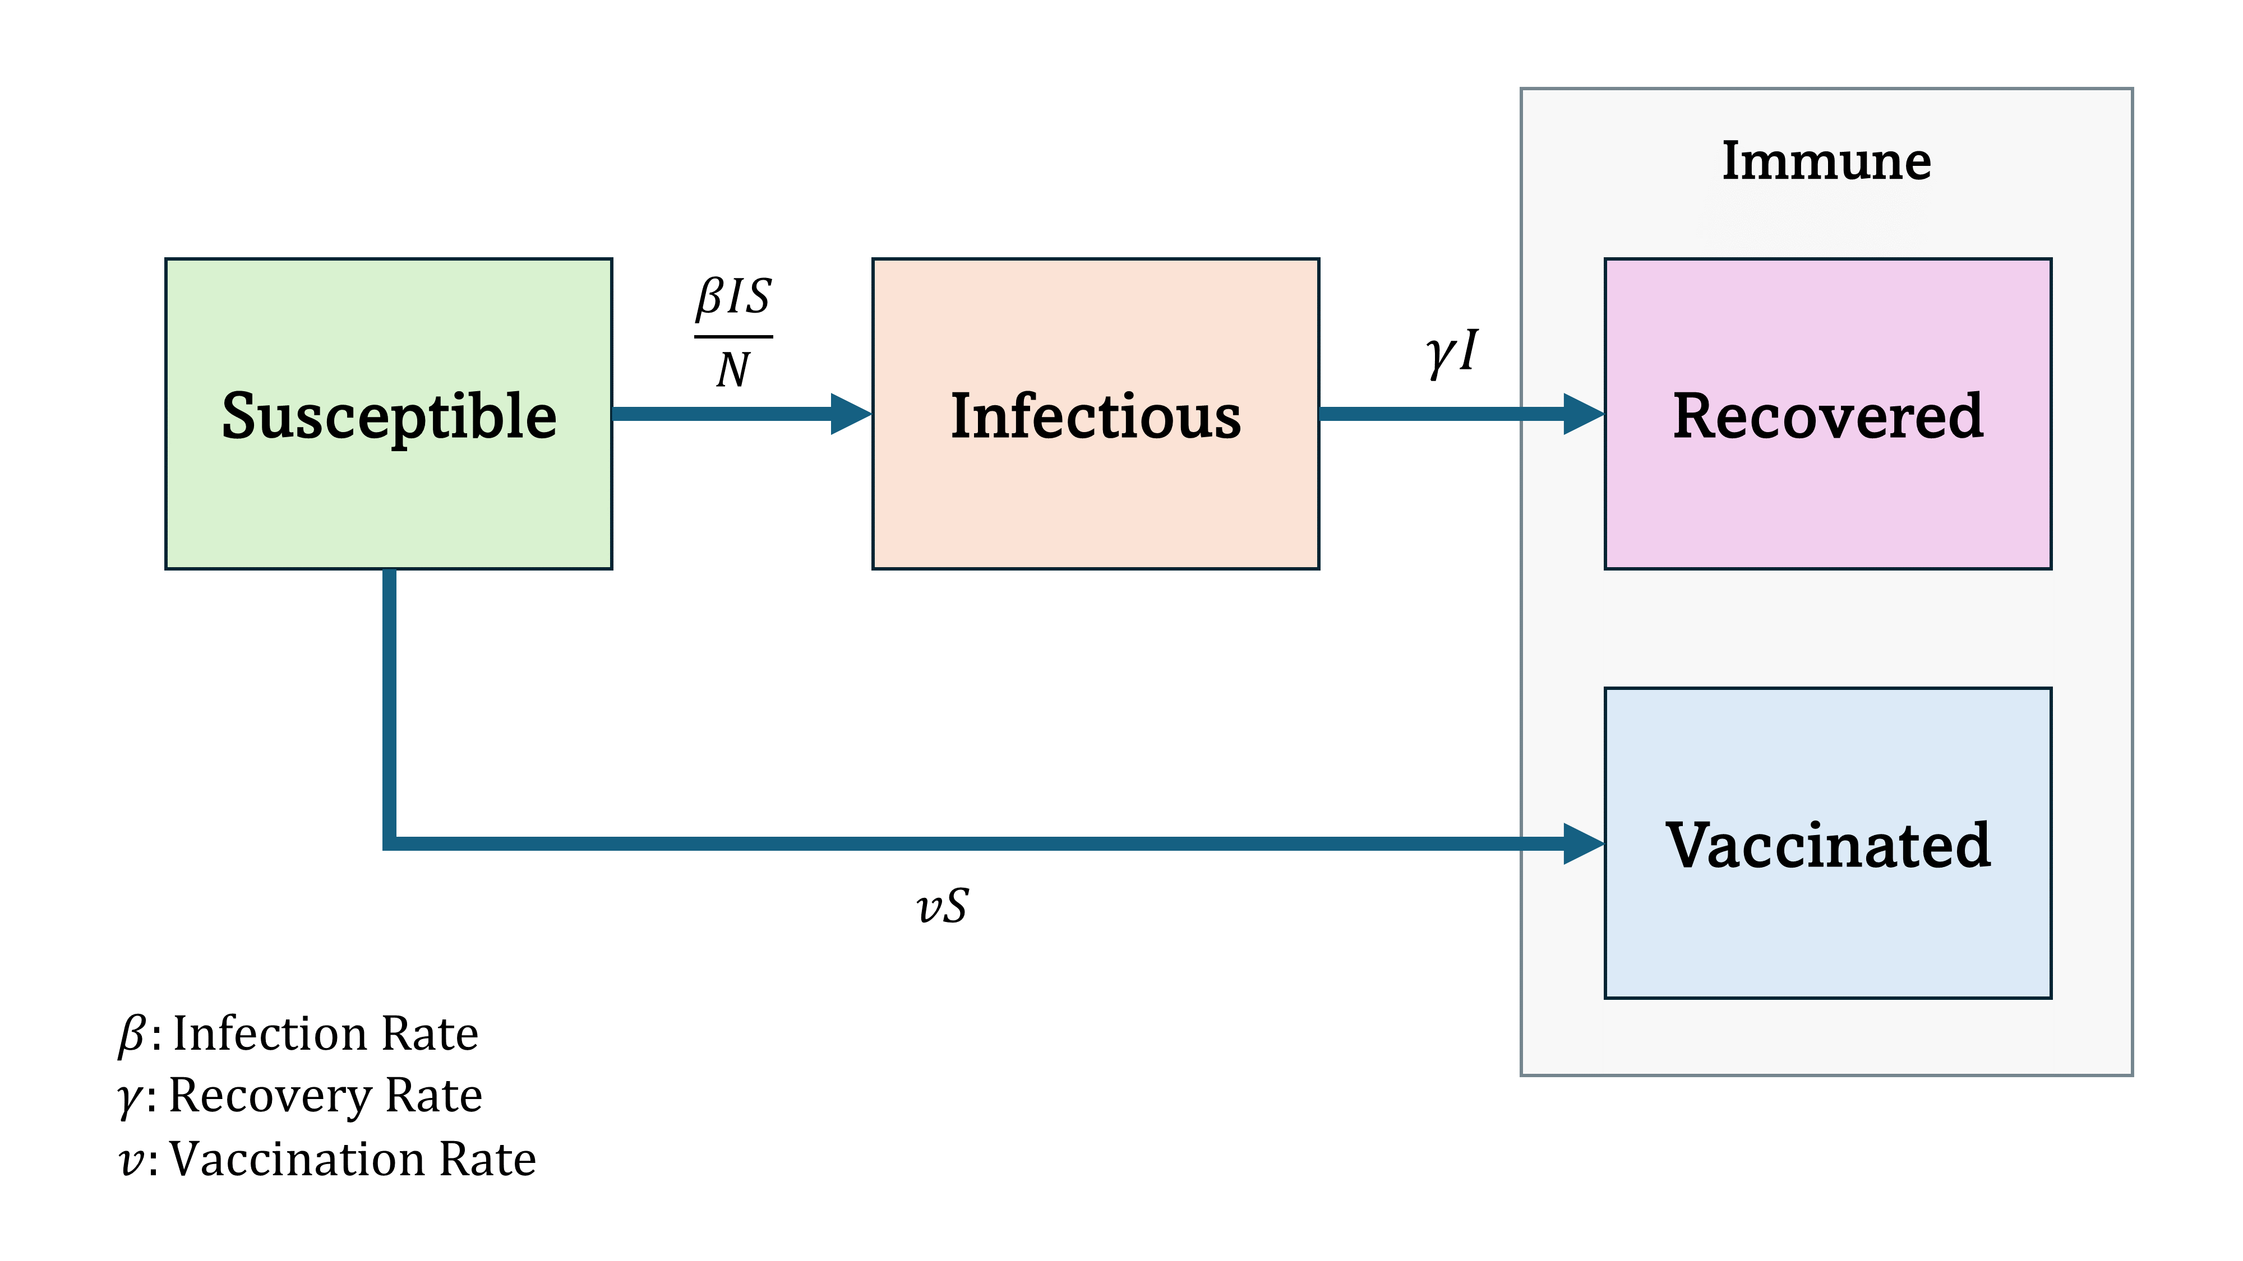
Traditional Models: SIRV
Susceptible – Infectious – Recovered – Vaccinated
Overview | Data Collection | Data Processing | Models | Results | Conclusion
24

Slide 25
Deep Learning Models
Recurrent Neural Networks
RNN Architecture
Input Layer
Processes the input sequence, feeding one element at a time into the network.
Hidden Layer
Contains recurrent connections that loop back, allowing the network to retain information from previous time steps.
Output Layer
Produces an output for each time step based on the current hidden state.
Overview | Data Collection | Data Processing | Models | Results | Conclusion
25

Slide 26
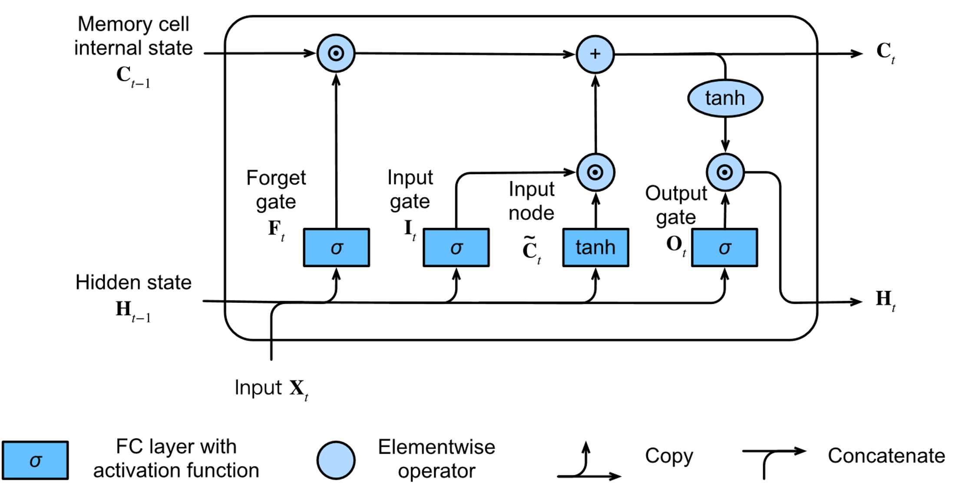
Deep Learning Models
Long-Short Term Memory
LSTM Architecture
Input gate
Controls the extent to which a new value flows into the cell.
Forget gate
Regulates the amount of information to forget.
Output gate
Determines the final output and how much it impacts the hidden state.
Overview | Data Collection | Data Processing | Models | Results | Conclusion
26

Slide 27
Deep Learning Models
Gated Recurrent Unit
GRU Architecture
Reset
Gate
Determines how much of the previous hidden state to forget.
Update
Gate
Controls the amount of the new hidden state to retain and the degree to which the previous hidden state should be carried forward.
Simplification of GRU compared to other models, by combining the hidden state and the cell state into a single state, using two gates to control the flow of information.
Overview | Data Collection | Data Processing | Models | Results | Conclusion
27

Slide 28
Deep Learning Models
Comparison of the Three Models
Model | MAE | RMSE | R-square
RNN | 0.70 | 0.91 | -0.27
LSTM | 0.83 | 0.97 | -0.47
GRU | 0.83 | 0.97 | -0.47
Overview | Data Collection | Data Processing | Models | Results | Conclusion
28

Slide 29
Deep Learning Models
Stacked LSTM
LSTM
Layer
LSTM
Layer
LSTM
Layer
LSTM
Layer
LSTM
Layer
Overview | Data Collection | Data Processing | Models | Results | Conclusion
29

Slide 30
Deep Learning Models
Stacked LSTM
LSTM
Layer
LSTM
Layer
LSTM
Layer
LSTM
Layer
LSTM
Layer
By leveraging multiple LSTM layers, stacked LSTM networks can learn more intricate patterns and provide more accurate predictions for sequential data.
Overview | Data Collection | Data Processing | Models | Results | Conclusion
30

Slide 31
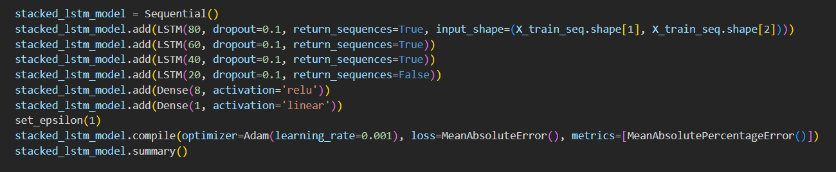
Deep Learning Models
Stacked LSTM
Overview | Data Collection | Data Processing | Models | Results | Conclusion
31

Slide 32
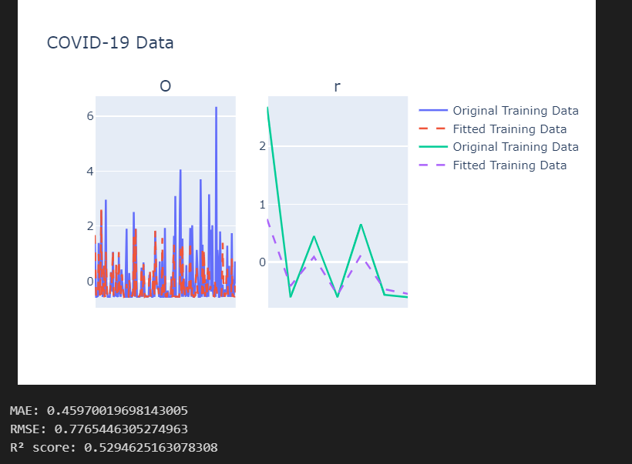
Deep Learning Models
Stacked LSTM
Model | MAE | RMSE | R-square score
Stacked LSTM | 0.53 | 0.79 | 0.51
Stacked LSTM
Prediction Results
Overview | Data Collection | Data Processing | Models | Results | Conclusion
32

Slide 33
Deep Learning Models
Convolutional Long-Short Term Memory
Input Sequence
Convolutional Layers
A series of sequential data frames, representing spatial information and patterns over time for further processing.
Apply convolutional filters to each frame to extract and highlight important patterns, edges, and textures.
Output Layer
LSTM Layers
Generate final predictions based on the processed spatiotemporal features.
Capture temporal dependencies while maintaining spatial structure, using convolutional operations within LSTM cells.
Overview | Data Collection | Data Processing | Models | Results | Conclusion
33

Slide 34
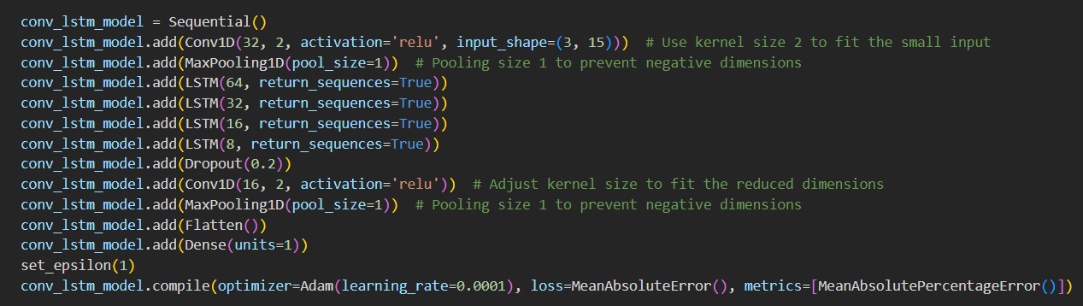
Deep Learning Models
Convolutional LSTM
Overview | Data Collection | Data Processing | Models | Results | Conclusion
34

Slide 35
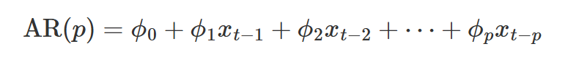
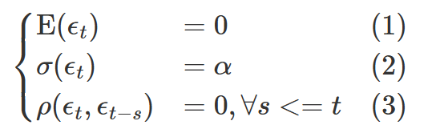
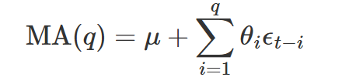
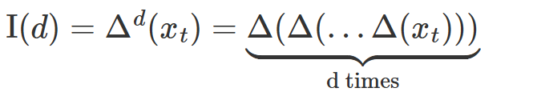
ARIMA Model
AutoRegressive Integrated Moving Average
Auto Regression:
Moving Average:
Integrated:
Overview | Data Collection | Data Processing | Models | Results | Conclusion
35

Slide 36
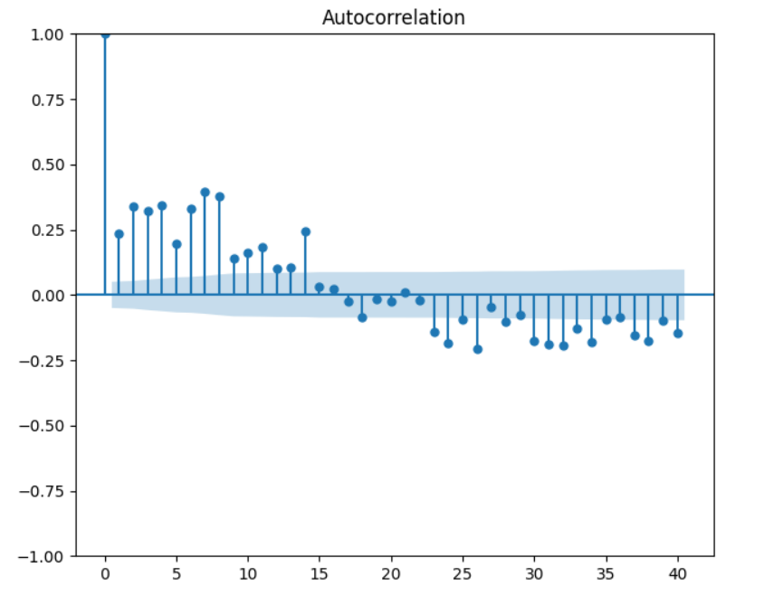
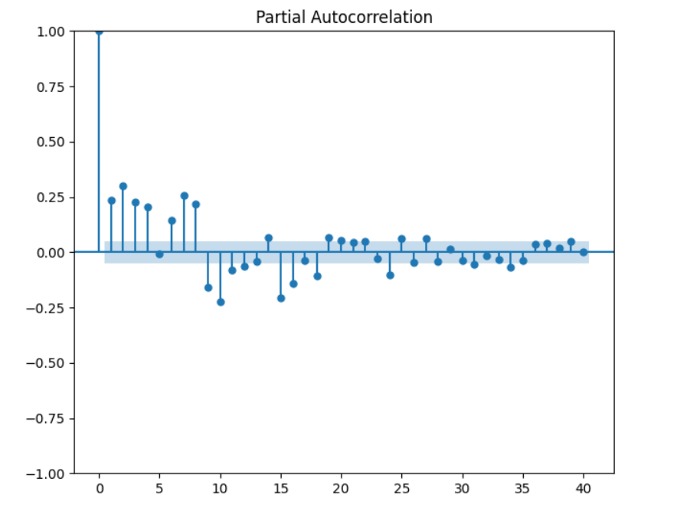
ARIMA Model
AutoRegressive Integrated Moving Average
ACF
(Autocorrelation Function)
PACF
(Partial Autocorrelation Function)
Overview | Data Collection | Data Processing | Models | Results | Conclusion
36

Slide 37
ARIMA Model
AutoRegressive Integrated Moving Average
ARIMA (p, d, q) function:
ACF (Autocorrelation Function): helps identify value for q.
PACF (Partial Autocorrelation Function): helps identify value for p.
Augmented Dickey-Fuller (ADF) Test: Normally, the time series will be stationary with d = 0 or d = 1.
Overview | Data Collection | Data Processing | Models | Results | Conclusion
37

Slide 38
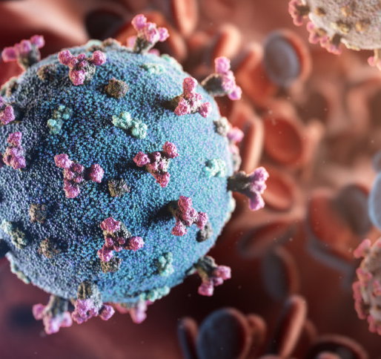
Results
Numbers and Figures Inferred from Data

Slide 39

Results
Numbers and Figures Inferred from Data
Evaluation Metrics
MAE
Mean Absolute Error
RMSE
Root Mean Square Error
$$R^{2}$$
R-squared
Overview | Data Collection | Data Processing | Models | Results | Conclusion
39

Slide 40
Results
Model comparison
Model | MAE | RMSE | R-square score
LSTM | 0.83 | 0.97 | -0.47
RNN | 0.70 | 0.91 | -0.27
GRU | 0.83 | 0.97 | -0.47
Stacked LSTM | 0.53 | 0.79 | 0.51
Convolutional LSTM | 1.05 | 1.17 | -0.21
ARIMA Model | 0.00008 | 0.0001 | 0.20
Overview | Data Collection | Data Processing | Models | Results | Conclusion
40

Slide 41
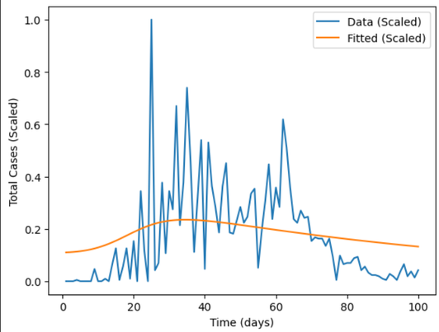
Results
Model comparison
Susceptible – Infectious – Recovered – Vaccinated (SIRV)
Prediction Results
Overview | Data Collection | Data Processing | Models | Results | Conclusion
41

Slide 42
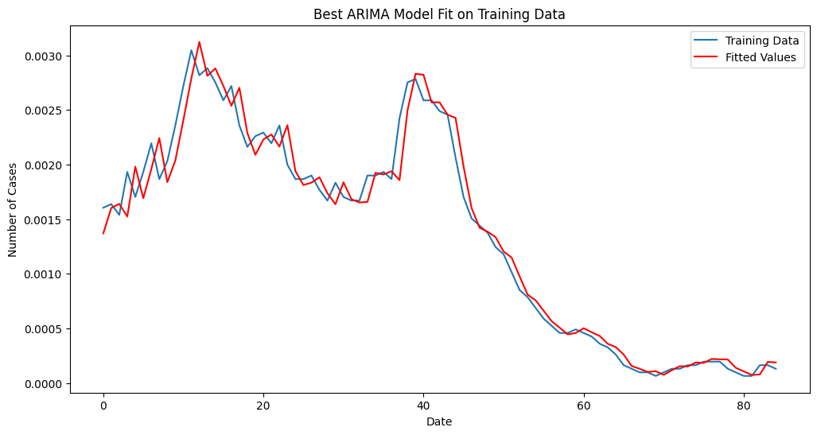
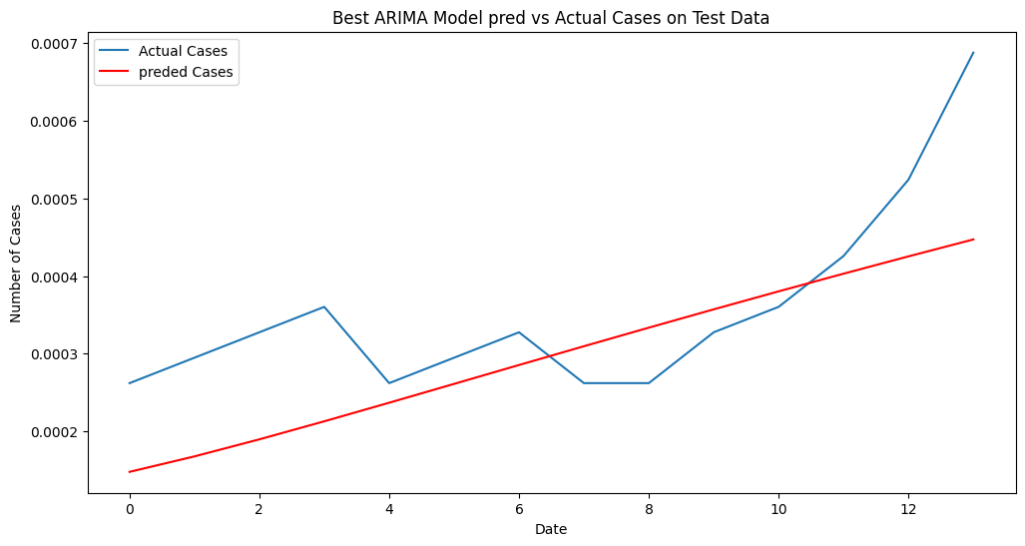
Results
Model comparison
Model | MAE | RMSE | R-square score
ARIMA Model | 0.00008 | 0.0001 | 0.20
Overview | Data Collection | Data Processing | Models | Results | Conclusion
42

Slide 43
Results
Model comparison
Model | MAE | RMSE | R-square score
Stacked LSTM | 0.53 | 0.79 | 0.51
Stacked LSTM
Prediction Results
Overview | Data Collection | Data Processing | Models | Results | Conclusion
43

Slide 44

Conclusion
Experimentation Results Comparison

Slide 45
Conclusion
Pros and Cons of Each Approach
PROS
CONS
SIR
SIRV
Understood phases of a pandemic
Captured basic epidemic dynamics
Struggled with complex patterns and unexpected infection waves
ARIMA
Captured linear temporal dependencies Effective in short-term
Did not handle non-linearities and long-term dependencies well
Deep Learning
Captured temporal and spatiotemporal dependencies well
May be improved to handle additional features better
Overview | Modelling | CP-Solver | Greedy Algorithm | Local Search | Conclusion
45

Slide 46
Thank you!

